Slide 1
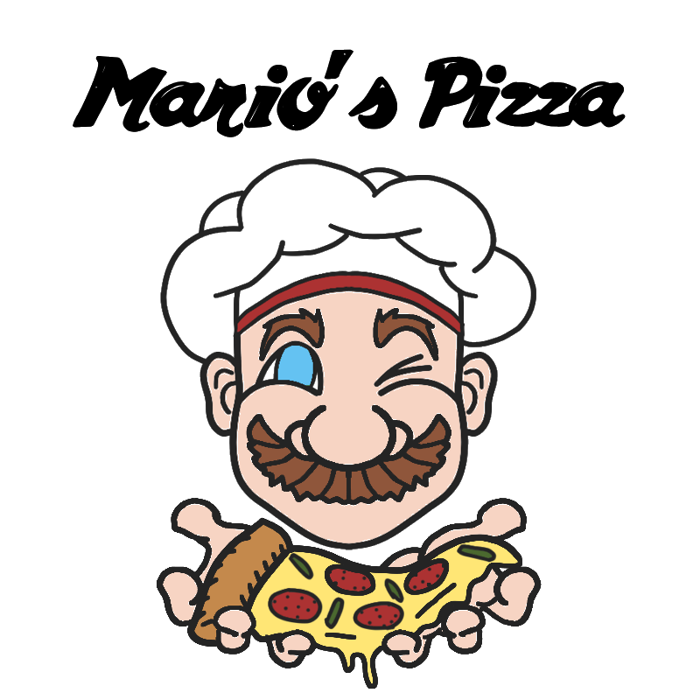
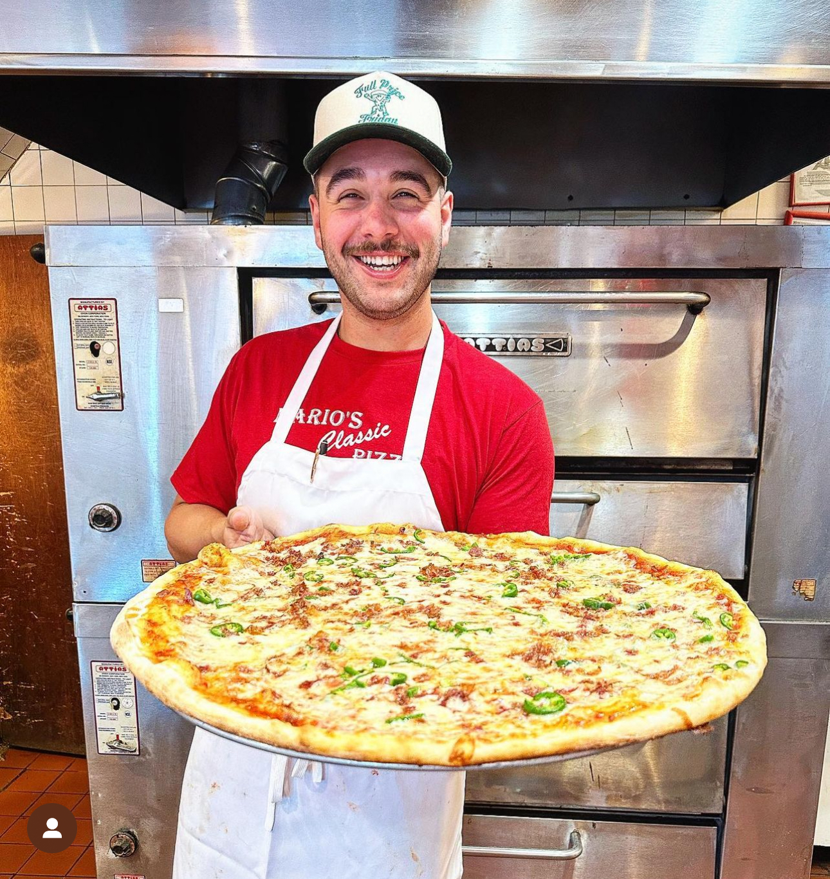
Mario's Pizza:
Comprehensive ‘Marketing Analysis
Exploring Innovative Strategies for a Classic Hoboken Pizzeria
SUSHIL RAJEEVA BHANDARY
SABITHA RACHEL NAZARETH
NAVEEN
DRITHI
Notes:
Entered text
We developed a comprehensive PowerPoint presentation for Mario's Pizza, detailing market analysis and strategies. It includes an introduction, executive summary, deep dives into customer demographics, a detailed business overview, SWOT and competitive analysis, marketing and sales objectives, a strategic marketing plan, a schedule for implementation, adaptable contingency plans, and a budget breakdown with projected growth. Each slide is designed to provide insightful data and actionable strategies for business enhancement. Just do the thank you page

Slide 2
Introduction
Mario’s Background
Established in 1986, Mario's Pizza is a family-run pizzeria in Hoboken, known for its unique baseball theme and commitment to authentic, quality pizza.
Purpose of the analysis
This analysis aims to evaluate Mario's Pizza's current market position, identify opportunities for growth, and recommend strategic marketing initiatives.
Agenda of the presentation
Target Market Analysis
SWOT Analysis
Competitive Landscape
Marketing Goals and Strategies
Implementation and Budget

Slide 3
Understanding Mario’s Customers
Demographics
Families and couples as primary customers.
Strong local and loyal customer base.
Psychographics and Trends
Preference for authentic, family-oriented dining.
Interest in unique themes like Mario's baseball decor.
Agenda of the presentation
Insight into customer preferences for strategic marketing.
Outline of presentation structure.

Slide 4
Mario’s Business
Product positioning
Wide Range of Starters (Veg, Non-veg, Sea-Food)
Variety of Drinks for all age (beer, coke, fresh)
Signature Dishes (Pizza, pasta, salad)
distribution channels
Dine-In Services.
Phone Orders.
GrubHub Partnership.
Pricing strategies
Great Intro Price: Low price on base pizzas and beer($2).
Dynamic Adjustments: Lowering prices on least sold products to boost sale.
Promotional Pricing: special pricing on special events & new platforms to boost sale
Promotional Activities
Social Media Campaigns.
Promotional Offers.
Running Ads
Encouraging Customer Review

Slide 5
SWOT Analysis
S
STRENGTH
💪🏻
w
WEAKNESS
📉
O
OPPORTUNITY
💡
T
THREAT
⚠️
Unique Family run authenticity
Niche Beer and pizza Combo
Prime location
Less insights of Local Competitors
Lack of Large Scale marketing effectiveness
Limited seating capacity
Expansion during peak hours
Diversifying Menu
Limited seating capacity
Rising raw material price
Rising labor cost
Competitive Market

Slide 6

Marketing and Sales Goals
Increase Lunchtime Business:
Targeting the local workforce and students with special lunchtime offers.
Promote quick-service options to attract time-constrained customers
Enhance Social Media Presence:
Grow followers and engagement on platforms like Instagram and TikTok.
Implement targeted ads and influencer collaborations to reach a broader audience.
Enhance Social Media Presence:
Introduce new menu items and limited-time offers to drive sales.
Implement loyalty programs to encourage repeat business
Streamline Online Ordering:
Develop an efficient online ordering system to improve customer convenience.
Partner with additional delivery services to expand reach.
Community Engagement:
Increase involvement in local events, particularly those related to baseball.
Offer special deals and promotions tied to local sports events and activities.

Slide 7

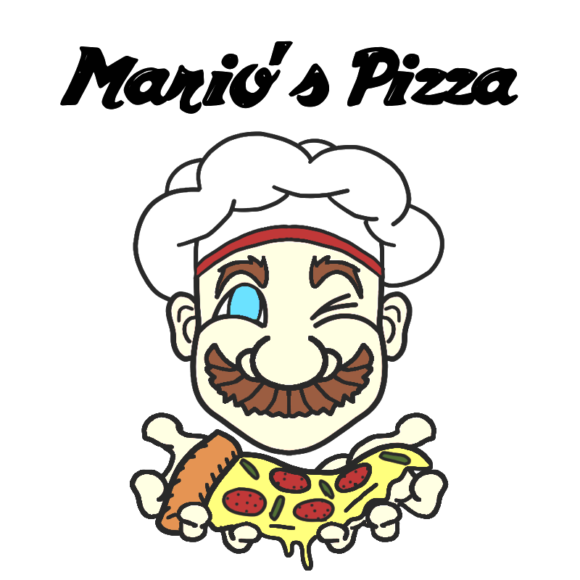
Marketing Strategy and Action Plan
Product positioning
Emphasize Authenticity: Highlight Mario's family-run, traditional approach in all marketing materials
Unique Theme: Utilize the baseball theme to create a distinct brand identity.
Promotions
Enhanced Social Media Campaigns: Intensify presence on Instagram & TikTok with interactive content & influencer partnerships.
Community-Focused Promotions: Sponsor local events, especially baseball-related, to reinforce theme & engage the local community.
Pricing strategies
Gradual Price Adjustment: Implement slight price increases while communicating the value and quality of offerings
Dynamic Pricing for Specials: Introduce special deals during low-peak hours to attract more customers.
Distribution Enhancement
Streamline Online Ordering: Develop an easy-to-use online ordering system to improve customer experience.
Expand Delivery Options: Partner with more delivery platforms to increase reach and convenience for customers.
Product positioning
Emphasize Authenticity: Highlight Mario's family-run, traditional approach in all marketing materials
Unique Theme Engagement: Utilize the baseball theme to create a distinct brand identity.

Slide 8

Implementation Schedule
Launch of Lunchtime Specials:
Introduce new lunch deals.
Start staff training for quick-service efficiency.
Enhance Social Media Campaigns:
Roll out targeted Instagram and TikTok campaigns
Begin local influencer collaborations.
Operational Adjustments:
Implement online ordering system.
Assess and adjust pricing strategy based on customer feedback.
Community Engagement Initiatives:
Sponsor local events, especially baseball-related.
Evaluate the effectiveness of marketing strategies and plan adjustments for the next year.
Ongoing: Monitor and Optimize:
Sponsor local events, especially baseball-related.
Evaluate the effectiveness of marketing strategies and plan adjustments for the next year.

Slide 9
Contingency Plans
Market Changes Response:
1. Adapt Menu to Economic Shifts: Introduce cost-effective alternatives if ingredient prices rise.
2. Flexible Pricing Strategy: Adjust prices in response to market conditions while maintaining value perception.
Sales Goals Not Met:
1. Supply Chain Alternatives: Amplify marketing efforts through additional social media campaigns and local promotions.
2. Flexible Pricing Strategy: Adjust prices in response to market conditions while maintaining value perception.
Operational Challenges:
1. Supply Chain Alternatives: Identify backup suppliers to mitigate risks of supply disruptions.
2. Efficient Resource Management: Optimize staff scheduling and energy use to reduce operational costs.
Digital Presence Setbacks:
1. Diversify Online Platforms: Expand online presence beyond Instagram & TikTok to other platforms like Facebook or a dedicated blog.
2. Efficient Resource Management: Optimize staff scheduling and energy use to reduce operational costs.
Community Engagement Obstacles:
1. Virtual Community Events: In case of limitations on physical gatherings, host online events or virtual cook-alongs.
2. Collaborate with Local Businesses: Partner with other Hoboken businesses for cross-promotional activities.

Slide 10
Budget and Projected Growth
Marketing Budget Breakdown:
Social Media Marketing: $500-$1000/month for content creation and paid ads.
Loyalty Programs: Around $100/month for a digital loyalty app.
Community Engagement: Approximately $200/month for local sponsorships events.
Operational Budget Adjustments:
Online Ordering System: Estimated initial setup cost and monthly maintenance.
Supply Chain Optimization: Budget allocation for potential new suppliers or efficiency improvements.
Projected Growth:
Revenue Increase from Pricing Strategy: Estimate additional revenue from slight price increases, while maintaining customer count.
Sales Growth from Marketing Efforts: Projected increase in sales due to enhanced marketing and promotional activities.
Contingency Funds and ROI Evaluation
Allocate a portion of the budget for unexpected expenses or market change.
Plan to regularly assess the return on investment for each marketing initiative to ensure efficient budget usage.

Slide 11
Thank you for your time 😊

